Slide 1


Slide 2
Contents
Hydraulic Jump

Slide 3
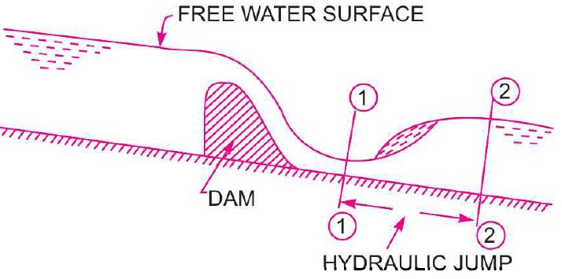
Hydraulic jump
The rise of water level, which takes place due to the transformation of the Unstable Shooting (Super-Critical) Flow to the Stable Streaming (Sub-Critical) Flow.

Slide 4
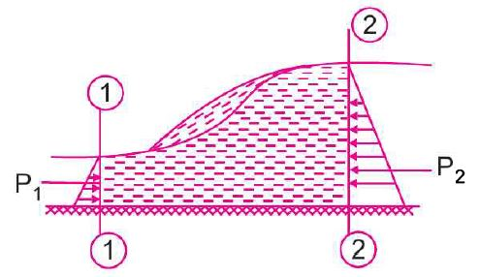
Hydraulic jump – Expression for Depth
In the analysis of hydraulic jumps, the following assumptions are made
The Flow is Uniform and Pressure Distribution is due to Hydrostatic; before and after the Jump.
Losses due to Friction on the surface of the bed of the channel are Small and hence Neglected.
The Slope of the bed of the channel is very Small, so that the Component of the Weight of the fluid in the direction of the flow is Neglected.

Slide 5
Hydraulic jump – Expression for Depth
Forces acting on the Mass of water b/w sections 1 and 2
Pressure Force, p₁
Pressure Force, p₂
Frictional Force - on the floor of the channel

Slide 6
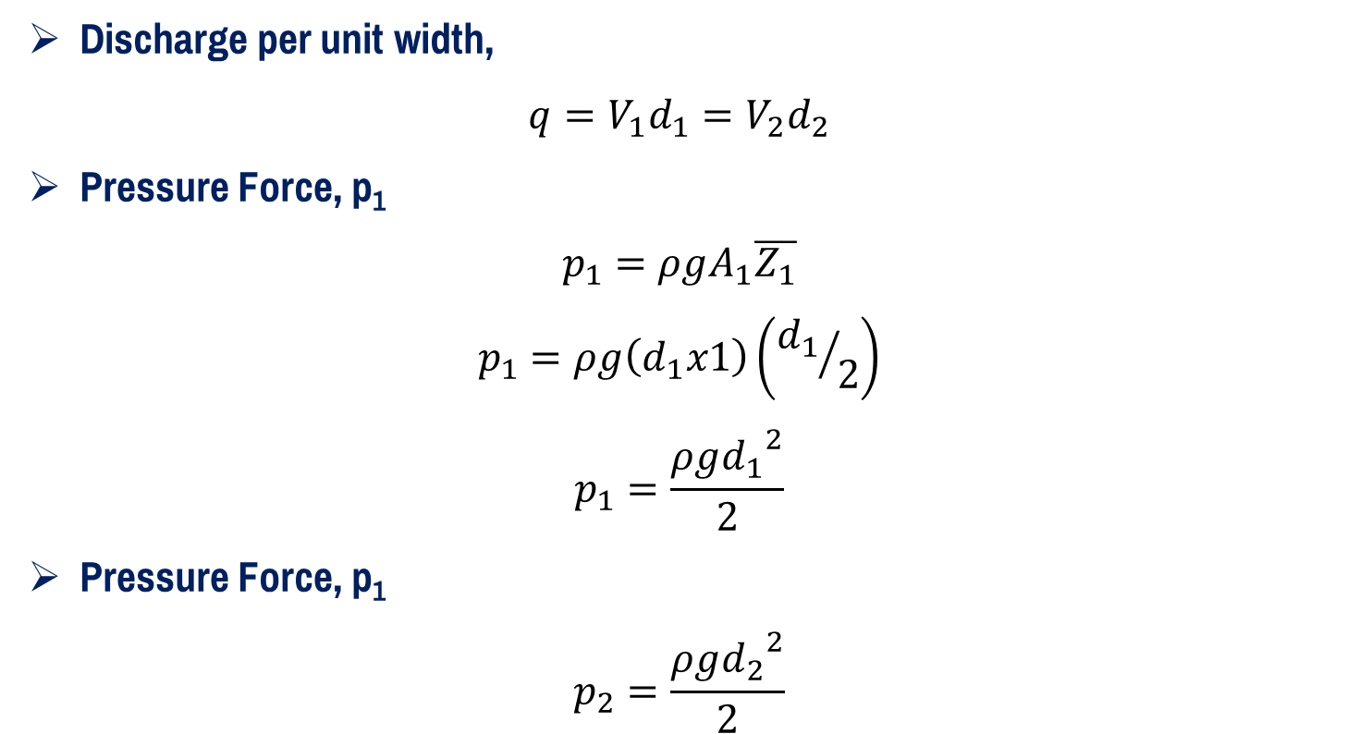
Hydraulic jump – Expression for Depth
Discharge per unit width,
$$q=V_{1}d_{1}=V_{2}d_{2}$$
Pressure Force, p₁
$$p_{1}=ρgA_{1}\overline{Z_{1}}$$
$$p_{1}=ρg\left(d_{1}x1\right)\left({d_{1}}/2\right)$$
$$p_{1}=\frac{ρg{d_{1}}^{2}}{2}$$
Pressure Force, p₁
$$p_{2}=\frac{ρg{d_{2}}^{2}}{2}$$

Slide 7
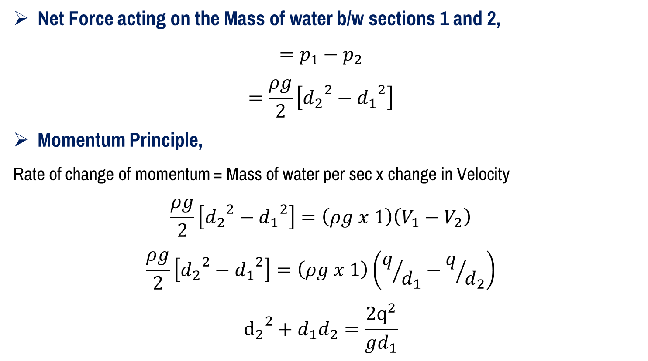
Hydraulic jump – Expression for Depth
Net Force acting on the Mass of water b/w sections 1 and 2,
$$=p_{1}−p_{2}$$
$$=\frac{ρg}{2}\left[{d_{2}}^{2}−{d_{1}}^{2}\right]$$
Momentum Principle,
Rate of change of momentum = Mass of water per sec x change in Velocity
$$\frac{ρg}{2}\left[{d_{2}}^{2}−{d_{1}}^{2}\right]=\left(ρg x 1\right)\left(V_{1}−V_{2}\right)$$
$$\frac{ρg}{2}\left[{d_{2}}^{2}−{d_{1}}^{2}\right]=\left(ρg x 1\right)\left(q/{d_{1}}−q/{d_{2}}\right)$$
$${d_{2}}^{2}+d_{1}d_{2}=\frac{2q^{2}}{gd_{1}}$$

Slide 8
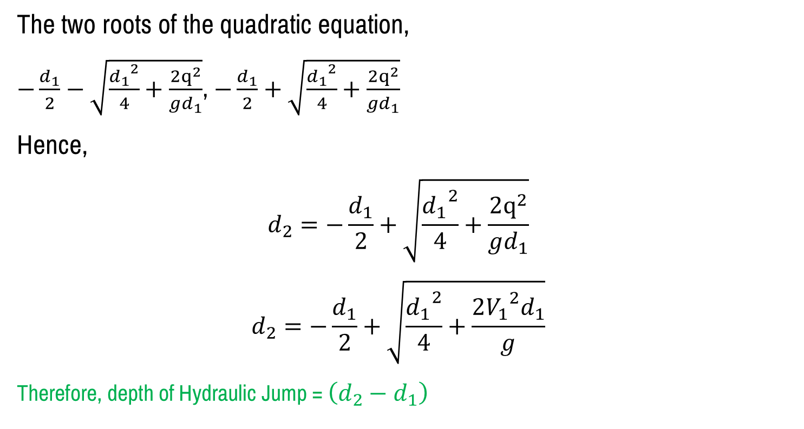
Hydraulic jump – Expression for Depth
The two roots of the quadratic equation,
$−\frac{d_{1}}{2}−\sqrt{\frac{{d_{1}}^{2}}{4}+\frac{2q^{2}}{gd_{1}}}$, $−\frac{d_{1}}{2}+\sqrt{\frac{{d_{1}}^{2}}{4}+\frac{2q^{2}}{gd_{1}}}$
Hence,
$$d_{2}=−\frac{d_{1}}{2}+\sqrt{\frac{{d_{1}}^{2}}{4}+\frac{2q^{2}}{gd_{1}}}$$
$$d_{2}=−\frac{d_{1}}{2}+\sqrt{\frac{{d_{1}}^{2}}{4}+\frac{2{V_{1}}^{2}d_{1}}{g}}$$
Therefore, depth of Hydraulic Jump = $\left(d_{2}−d_{1}\right)$

Slide 9

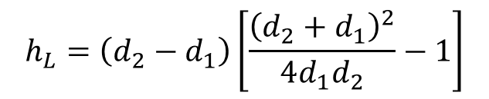
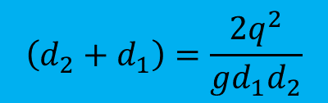
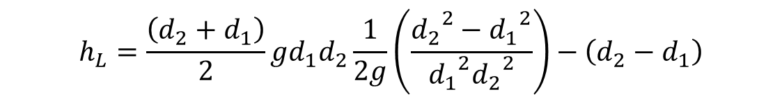
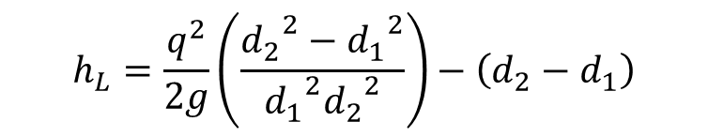
Hydraulic jump – Expression for Loss of Energy
$$h_{L}=\frac{q^{2}}{2g}\left(\frac{{d_{2}}^{2}−{d_{1}}^{2}}{{d_{1}}^{2}{d_{2}}^{2}}\right)−\left(d_{2}−d_{1}\right)$$
$$\left(d_{2}+d_{1}\right)=\frac{2q^{2}}{gd_{1}d_{2}}$$
$$h_{L}=\frac{\left(d_{2}+d_{1}\right)}{2}gd_{1}d_{2}\frac{1}{2g}\left(\frac{{d_{2}}^{2}−{d_{1}}^{2}}{{d_{1}}^{2}{d_{2}}^{2}}\right)−\left(d_{2}−d_{1}\right)$$
$$h_{L}=\left(d_{2}−d_{1}\right)\left[\frac{{\left(d_{2}+d_{1}\right)}^{2}}{4d_{1}d_{2}}−1\right]$$
$$h_{L}=\frac{{\left(d_{2}−d_{1}\right)}^{3}}{4d_{1}d_{2}}$$

Slide 10
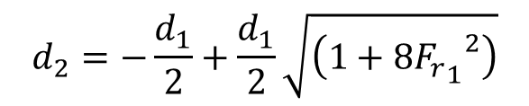
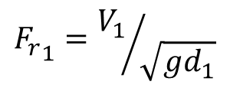
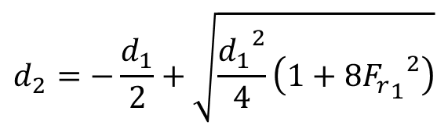
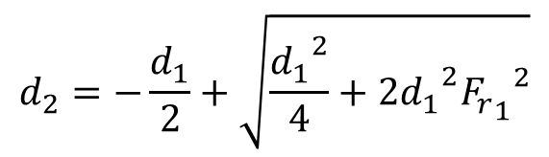
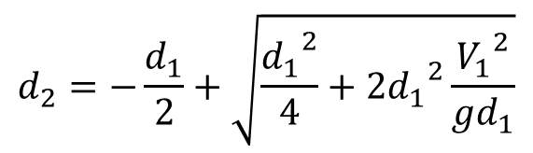
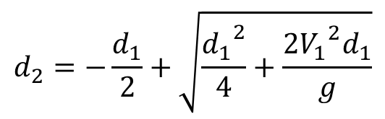
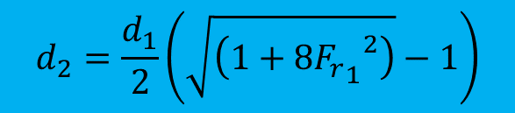
Hydraulic jump – Expression for Depth in terms of Fr
$$d_{2}=−\frac{d_{1}}{2}+\sqrt{\frac{{d_{1}}^{2}}{4}+\frac{2{V_{1}}^{2}d_{1}}{g}}$$
$${F_{r}}_{1}={V_{1}}/{\sqrt{gd_{1}}}$$
$$d_{2}=−\frac{d_{1}}{2}+\sqrt{\frac{{d_{1}}^{2}}{4}+2{d_{1}}^{2}\frac{{V_{1}}^{2}}{gd_{1}}}$$
$$d_{2}=−\frac{d_{1}}{2}+\sqrt{\frac{{d_{1}}^{2}}{4}+2{d_{1}}^{2}{{F_{r}}_{1}}^{2}}$$
$$d_{2}=\frac{d_{1}}{2}\left(\sqrt{\left(1+8{{F_{r}}_{1}}^{2}\right)}−1\right)$$
$$d_{2}=−\frac{d_{1}}{2}+\sqrt{\frac{{d_{1}}^{2}}{4}\left(1+8{{F_{r}}_{1}}^{2}\right)}$$
$$d_{2}=−\frac{d_{1}}{2}+\frac{d_{1}}{2}\sqrt{\left(1+8{{F_{r}}_{1}}^{2}\right)}$$

Slide 11
Hydraulic jump – Length
For a rectangular channel, the Length of the Hydraulic Jump is 5 or 7 times the Height of the Hydraulic Jump

Slide 12
numerical
Q1. The depth of flow of water, at a certain section of a rectangular channel of 4m wide, is 0.5m. This discharge through the channel is 16m³/s. If a hydraulic jump takes place on the downstream side, find the depth of flow after the jump.

Slide 13
numerical
Q2. A sluice gate discharges water into a horizontal rectangular channel with a velocity of 10m/s and depth of flow of 1m. Determine the depth of flow after the jump and consequent loss in total head.

Slide 14


